Slide 1
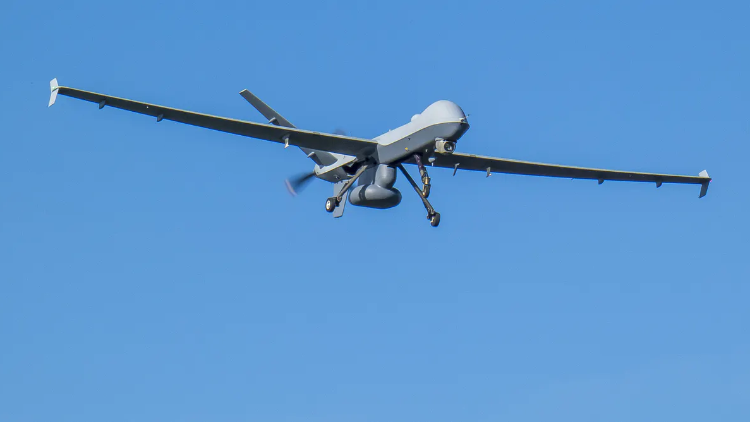
Surveillance using Kalman filter
Team – PERFECT DEALERS
K.Vishnu Sainadh – AIE19028
K.Satwik - AIE19034
V.Ashrith - AIE19066

Slide 2
Aim of the project
In this project we have implemented Kalman filter to estimate the position and velocity of the target
Problem : The target is now moving in xyz plane. Velocity of target is along X-axis 'a' m/sec , along Y-axis 'b' m/sec and 'c' m/sec along Z-axis. Starting point is 'x' m along x axis, 'y' m along y axis and 'z' m along z axis. After some time 't' what will be the position of the target ?

Slide 3
Contents
Introduction
Surveillance
Kalman filter
Why Kalman filter?
Advantages of Kalman filter
Results
Conclusion & Future Scope

Slide 4
Introduction
Surveillance means that keeping a close watch on someone
Surveillance in certain conditions is very difficult in such situations Kalman filter can be helpful
Our project is about using Kalman filter to improve the field of surveillance

Slide 5
Surveillance
Monitoring of behavior
It is used by governments for intelligence gathering, prevention of crime and also for investigation of crime etc.
Our project helps in the part of investigating crimes

Slide 6
Kalman filter
Filters are very important
Target tracking
Optimal estimator
It has 2 parts
Priori estimate (predict)
Posteriori estimate (update)

Slide 7
Why Kalman filter ?
Target tracking is often Difficult due to noise in measurements.
System need to filter out this noise to predict the true position and velocity of a target.
This work is done by the Kalman filter.

Slide 8
Advantages of Kalman filter
Kalman filter is robust to measurement noise and does not depend on good initial conditions
It can be used where you have uncertain information about some dynamic system
Kalman filter is ideal for systems which are continuously changing, they don’t need to keep any history other than previous state.

Slide 9
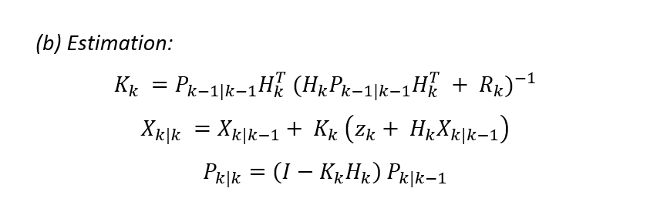
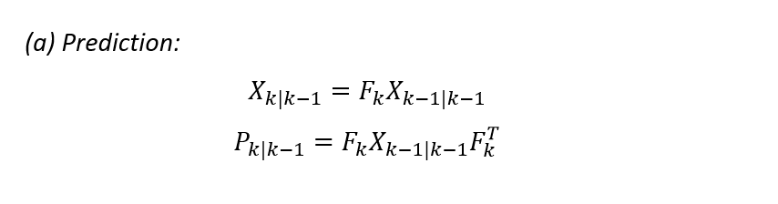
Kalman filter algorithm

Slide 10
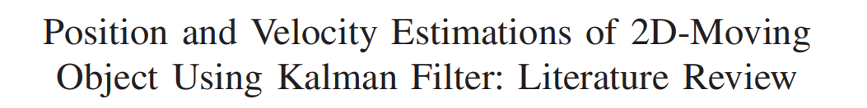
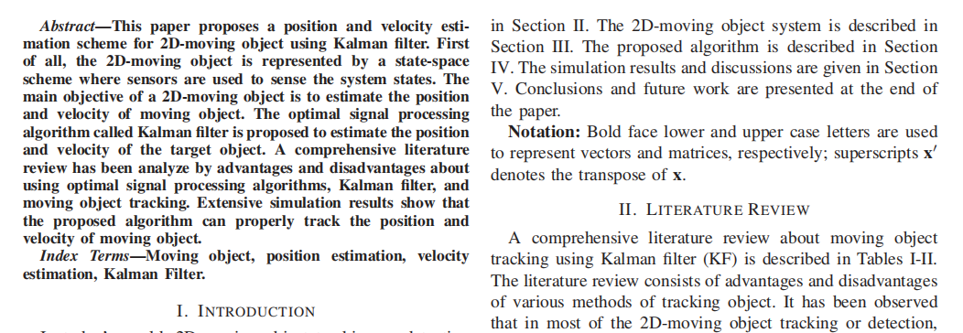

Slide 11
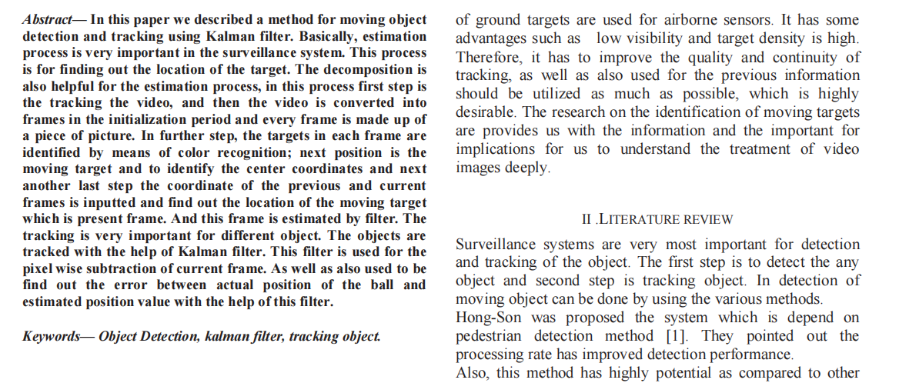

Slide 12
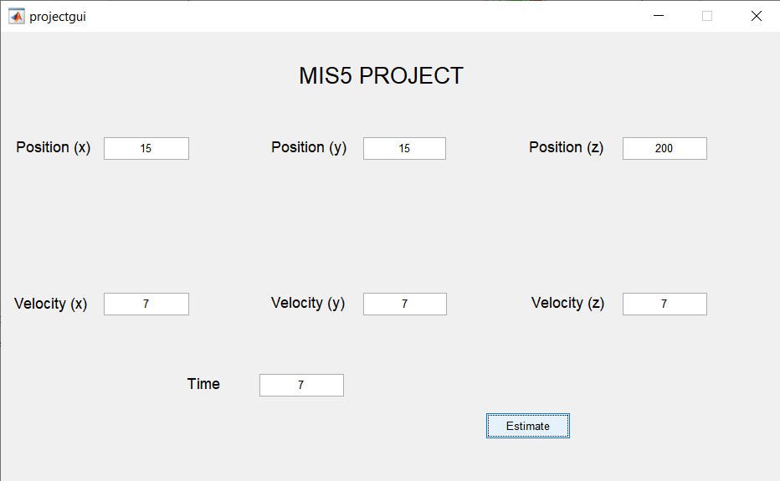
Results

Slide 13
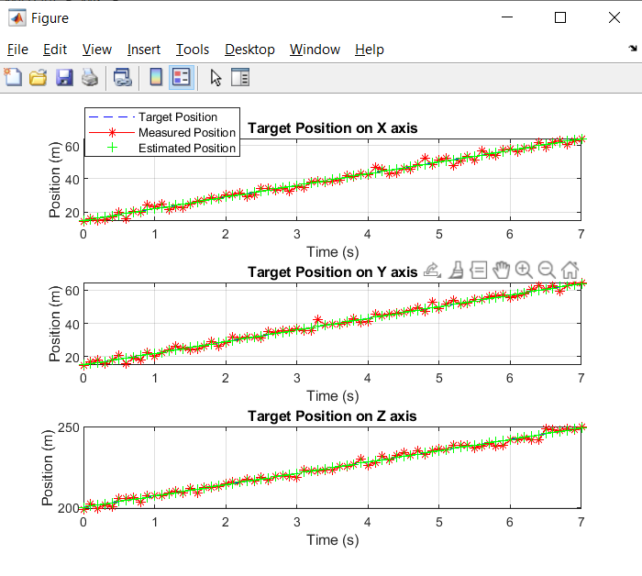
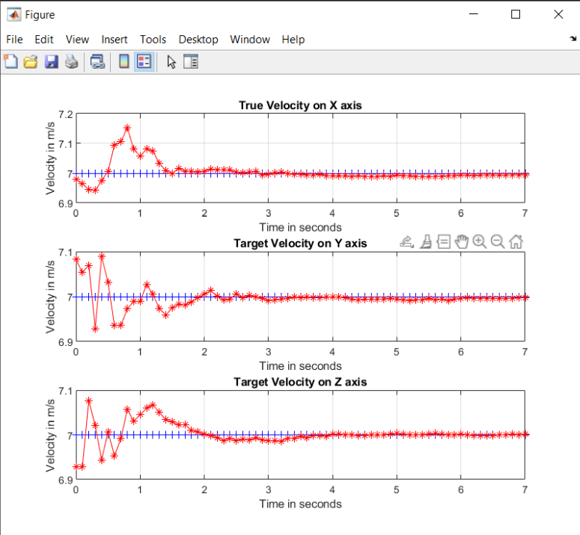

Slide 14
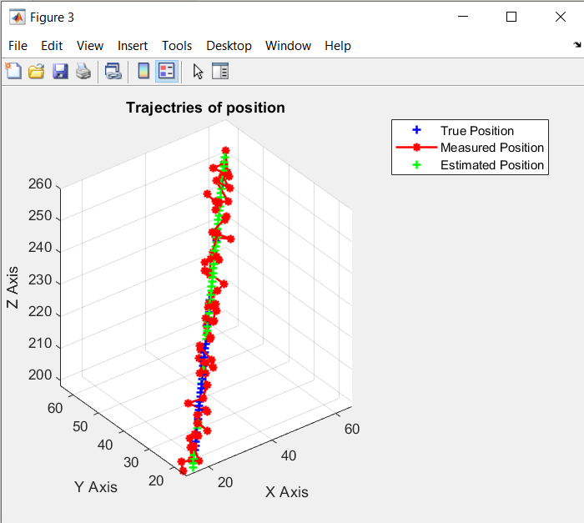
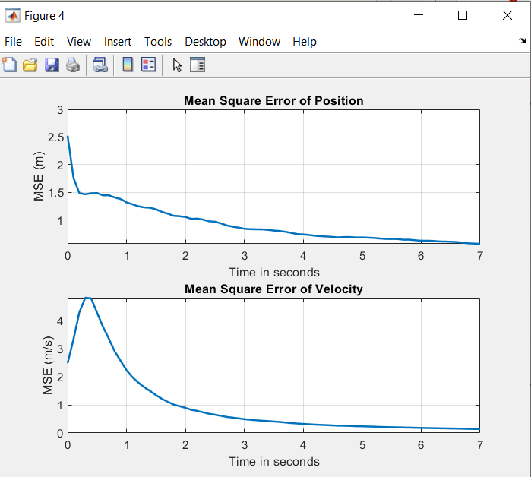

Slide 15
Conclusion and Future Scope
Our project demonstrates how Kalman filter can be used in the field of surveillance to estimate position and velocity of a moving object.
Kalman filter successfully reduced the variation in measurements guessing the true position and velocity.
This can be extended to many tracking applications like video surveillance

Slide 16
Let's see our demo

